Slide 1
Hacker Bootcamp
Lesson #2 : Linux Kernel

Slide 2
Course Materials
https://github.com/osteth/HackerBootcamp
Slides and Materials for this course will be updated in this repo before each class.

Slide 3
Class#2
Linux Kernel
What is the Kernel?
Why do I care?
How to compile a system specific kernel for better system performance.
How to apply a kernel patch.
How to edit the kernel.
Hardening the kernel against cyber threats.

Slide 4
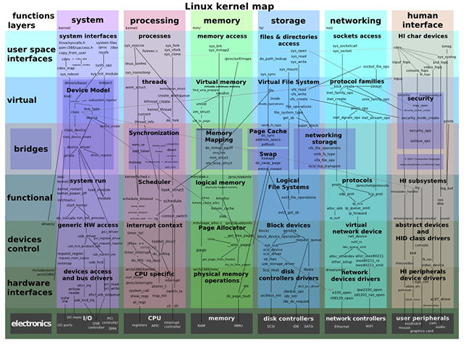

What is the Kernel?
Soldering (AmE: /ˈsɒdərɪŋ/, BrE: /ˈsɒldərɪŋ/), is a process in which two or more items (usually metal) are joined together by melting and putting a filler metal (solder) into the joint, the filler metal having a lower melting point than the adjoining metal.
Solder is not the name of a particular metal. Solder is any soft metal used to join two harder metals together via melting and fusing to the parts of the joint. Many different alloys and pure, elemental metals are used for soldering.
Notes:
The kernel is the essential center of a computer operating system, the core that provides basic services for all other parts of the operating system. A synonym is nucleus. A kernel can be contrasted with a shell, the outermost part of an operating system that interacts with user commands. Kernel and shell are terms used more frequently in Unix operating systems than in IBM mainframe or Microsoft Windows systems.
Typically, a kernel (or any comparable center of an operating system) includes an interrupt handler that handles all requests or completed I/O operations that compete for the kernel's services, a scheduler that determines which programs share the kernel's processing time in what order, and a supervisor that actually gives use of the computer to each process when it is scheduled. A kernel may also include a manager of the operating system's address spaces in memory or storage, sharing these among all components and other users of the kernel's services. A kernel's services are requested by other parts of the operating system or by application programs through a specified set of program interfaces sometimes known as system calls.
Because the code that makes up the kernel is needed continuously, it is usually loaded into computer storage in an area that is protected so that it will not be overlaid with other less frequently used parts of the operating system.
The kernel is not to be confused with the Basic Input/Output System (BIOS).
Some kernels have been developed independently for use in any operating system that wants to use it. A well-known example is the Mach kernel, developed at Carnegie-Mellon University, and currently used in a version of the Linux operating system for Apple's PowerMac computers.

Slide 5
Why do I care
Kernel Level Attack Vectors
I/O
Networking (CVE-2016-8655)
Memory (CVE-2016-5195)
Random Number Generator (basis of all cryptography such as https, etc.) (CVE-2017-7618)
EVERYTHING!!!!
The kernel handles all interactions between the operating system and the hardware making it essential to operation and making it very risk dense.
Reducing the codebase to include only system drivers specifically required for your system significantly improves system performance as well as radically reducing kernel attack surface.

Slide 6



Who’s uses the Linux Kernel?
Super Computers - 99.40%
Internet Connected Web Servers - 98.3%
Tablets - 98.4%
Smart Phones - 99.7%
Desktop and Laptop Computers - 48.98%
EVERYONE!!!!!!!!!!
Notes:
Stats pulled from https://en.wikipedia.org/wiki/Usage_share_of_operating_systems

Slide 7
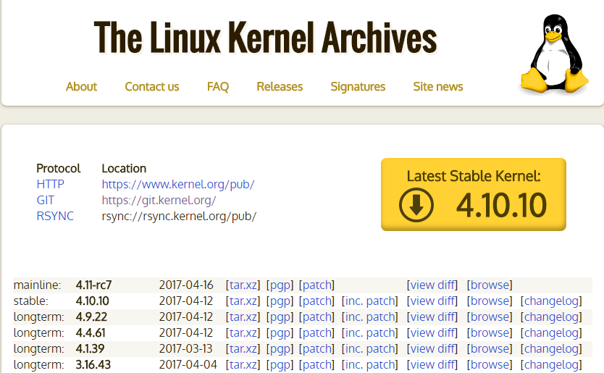
Step #1 Download the Kernel Source
Were to Get the Kernel Source
Download the latest Tarball from Kernel.org
Clone it from Github
git clone git://git.kernel.org/pub/scm/linux/kernel/git/stable/linux-stable.git
cd linux-stable
git tag -l | less
git checkout -b stable tag
Notes:
Here’s a decent 1 page runthrough: https://kernelnewbies.org/KernelBuild

Slide 8
Collect any Patches you wish to apply to the kernel
Boost system Performance
BFS (Brain Fuck Scheduler)
Available from:
http://ck.kolivas.org/patches/bfs/4.0/4.8/4.8-sched-bfs-512.patch
This is an alternative CPU scheduler that has proven to significantly increase system performance on the majority of system configurations.
Beef Up Security
GRsecurity
Is no-longer free to the public Read more here and be outraged!
Scaled back patches legally available from: https://grsecurity.net/download.php
Archived patches of questionable integrity available from: http://mirrors.muarf.org/grsecurity/stable/
Please support open source software creators
Notes:
Grsecurity patches dramatically improve kernel security however they were fairly well screwed over by IOT manufacturers not paying for licenses and have closed down their freely available patches to enforce their license.

Slide 9
Grab a copy of your current system config and do some setup
Install dependencies for compilation
sudo apt-get install build-essential kernel-package libncurses5-dev bzip2 fakeroot
Create a new working directory to put all of your kernel files into.
Your config files are located in your /boot directory. Copy a config to your new working directory.
Copy your kernel source and patches into this folder as well
Untar your linux source
Tar -xvf *name of file*
Make a symbolic link called linux that point to you untarred source directory.
ln -s *name of directory* linux
Notes:
Here’s a great youtube video of someone using the same method to compile a kernel as well https://www.youtube.com/watch?v=2EnR4fDPi8w

Slide 10
Setup - Patch - Configure
Enter your linux directory and cleanup the contents in preparation for the next steps
Make clean && make mrproper
Apply patches
patch -p1 < ../*patch name*
Copy base configuration into folder and rename it
cp ../*name of config file*/ .config
open menu configuration tool
Make menuconfig
Load .config into configuration tool
Make kernel configuration changes
Save configuration and exit configuration tool
Notes:
These steps will get your source code readied for compilation, patch that code with your patches, and configure compilation settings. You may end up doing this several times if the configuration fails and your computer will not boot. Recompiling is much faster than the first compile so minor changes are much faster.

Slide 11
Compile
Once everything is ready ready to compile issue the following command to build your kernel
fakeroot make-kpgk -j5 --initrd --append-to-version=add-your-kernel-name-here kernel_image kernel_headers
Explanation:
Fakeroot - you never want to compile a Kernel as root, fakeroot allows you to have access to root functionality you need from the system for compiling but not be root for the process.
Make - Make is how you compile the majority of programs from a linux machine. Adding the -kpkg flag to it instructs the computer that we are going to be building .deb packages
-j5 - Seth the number of simultaneous jobs that the computer should work on during the compilation. General rule for this is to set it to 1 more than the number of cores in your cpu.
--initrd - instructs the compiler to add initrd files to the package to that the system can boot directly into the kernel via kexec
--Append-to-version= - allows you to append notes or names to the package's name.
Kernel_image - instructs the compiler to build a kernel image package.
Kernel_headers - instructs the compiler to build a kernel header package for the kernel image.

Slide 12
Install
Ensure you are in a directory that contains only your newly compiled kernel packages.
Enter the following command:
sudo dpkg -i *.deb
This will install both the image and headers packages effectively installing the new kernel to your system.
Reboot the system to switch over to the new kernel.
If the kernel fails you should be prompted by GRUB to revert to your old kernel at which point you can make modifications and try again.
It can be slow and tedious work but it’s best to make small changes and make sure you never leave yourself without a working kernel configuration.

Slide 13
Certifications and Applications:
Linux Foundation Certified Engineer
LFCE Certification Courses https://training.linuxfoundation.org/certification/lfce
Less than 900 Linux Kernel jobs listed on linkedIn.
Most companies are unaware that the kernel exists let alone that it can be optimized for security, performance, or specialty applications.
Notes:
Compiling the linux kernel is something you will likely never actually NEED to do. Patching and compiling kernels for specific applications is an obscure and highly technical skillset that is difficult to attain on one's own. Tweaking small things in the kernel can make a HUGE impact on a system. Switching to a hardware specific kernel over a generic kernel can save large data company's immense amounts of money and patching for security in your kernel is similar to fixing a buildings foundation. There's no point to fixing the roof when the floor is falling into a sinkhole.

Slide 14
Extra Study:
Take the eudyptula challenge!
Previous talk I have given about a kernel level crypto issue
High risk kernel vulnerabilities database
Learn about the Armbian toolchain and how to cross compile kernels for embedded devices
https://buildroot.org/
Beginners guide to Kernel hacking

